Slide 1
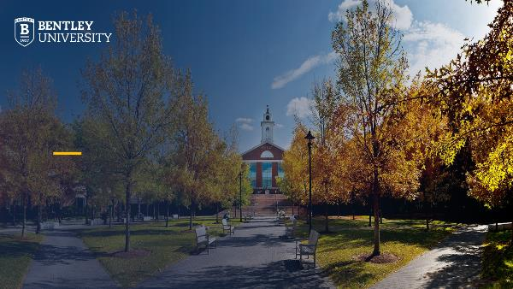
Presentation Guide | About Bentley Slides
This slide deck includes several slides that may be helpful if you need to include some “about Bentley” information in a presentation to an outside audience.
These slides were prepared in December of 2024. Please be sure to check Bentley.edu to confirm any rankings or salary data for graduates before using these slides.
To access the full Bentley-branded PowerPoint template, please visit Bentley.edu/brand/resources.

Slide 2
The History of Bentley University
More Than a Century of Reinventing Business Education
When Harry C. Bentley first convened a class of 30 students on Huntington Avenue in Boston in 1917, his goal was to educate the next generation of accountants. Since opening our doors over 100 years ago, Bentley University has continuously reinvented business education and grown from those humble beginnings to become one of the top business universities in the U.S.
As a transformative lifelong-learning community, we prepare over 5,000 undergraduate and postgraduate students each year to use their business know-how to make a positive difference in the world. With a community of over 65,000 proud Falcon alumni, the impacts of a Bentley education stretch around the globe.

Slide 3
Why Bentley?
Bentley University believes good business can impact more than the bottom line -- it can change the world. Bentley is a community of future business leaders who will deliver value in the marketplace and lasting positive effects for society. The university’s students are highly sought after, its faculty apply innovative research to real-world problems, and its alumni lead organizations around the world. Bentley educates the head and the heart with an innovative, technology-focused education that integrates the best of business and the arts and sciences and prepares the business leaders of tomorrow to lead successful, rewarding careers.
It’s just good business.

Slide 4
Bentley University is where good business begins
FORCES OF POSITIVE CHANGE
Bentley University has a clarity of purpose and an unwavering commitment to making a tangible difference. The successful business leaders of tomorrow will be expected to deliver real-time value in the marketplace as well as lasting positive outcomes for society. We are a community who will drive that positive impact — and the future of business.
UNPARALLELED IMPACT
Bentley University understands impact — it’s woven into everything we do. Since our founding days, this institution has maintained a resolute, comprehensive and sustained commitment to success and outcomes. It’s our core competence — and core promise. Students, faculty and staff come to Bentley with life-changing aspirations and achieve their goals here.
HOLISTIC BUSINESS EDUCATION
In a world marked by seismic change and grand challenges, Bentley University cultivates an environment that fosters ethical and moral principles, nurturing the development of well-rounded leaders poised to make an impact on the world stage. We deliver a highly innovative, technology-infused, future-focused business education and scholarship. With multidisciplinary academic programs, corporate collaborations and real-world partnerships, Bentley educates the head and heart with the best of business and the arts and sciences — and prepares the leaders of tomorrow to meet any challenge the global economy may bring.
Good business impacts the bottom line — and the world.

Slide 5
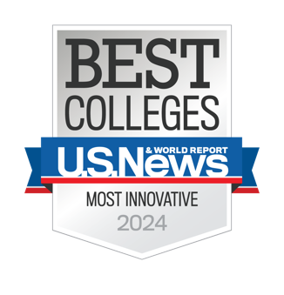

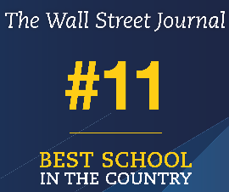
The Latest Rankings
Top (1st) Regional University in the North
US News Best Colleges Rankings 2024
Top 5 Innovative Universities in the North
US News Best Colleges Rankings 2024
Top 5 University for Earnings 10 Years After Graduation
New York Times College Ranking 2023
11th Best College in the Country
The Wall Street Journal’s 2025 Best Colleges in the US Ranking
Top 10 University for 20-Year Return on Investment
Georgetown University’s Center on Education and the Workforce
America's Best Colleges
Money Magazine Best Colleges 2024

Slide 6
A National Leader
#1
98%
#2
Undergraduate Career Services
Job
Placement Rate
Student Athlete Graduation Rate
The Princeton Review
Career Services
NCAA Division II Report
$73k
#1
Median Starting Salary
Most Innovative
Regional North
Career Services
U.S. News & World Report
Notes:
$733

Slide 7
